Slide 1
HDFS & MapReduce
Let us change our traditional attitude to the construction of programs: Instead of imagining that our main task is to instruct a computer what to do, let us concentrate rather on explaining to humans what we want the computer to do
Donald E. Knuth, Literate Programming, 1984
Notes:
http://www.manamplified.org/archives/2008/06/hadoop-quotes.html

Slide 2
Learning Objectives
Explain how the Lambda architecture differs from TPS and Data Warehousing
Explain the relationship between Map-Reduce and the Lambda architecture
Demonstrate how Map Reduce works to process data using a simple R program.

Slide 3
Drivers

Slide 4
Central activity

Slide 5
Dominant logics
Economy | Subsistence | Agricultural | Industrial | Service | Sustainable
Question | How to survive? | How to farm? | How to manage resources? | How to create customers? | How to reduce impact?
Dominant issue | Survival
 |  | Production
 |  |  |  | Customer service
 |  |  |  |  | Sustainability
Key information systems | Gesture Speech | Writing Calendar | Accounting ERP Project management | CRM Analytics | Simulation Optimization Design

Slide 6
Data sources

Slide 7
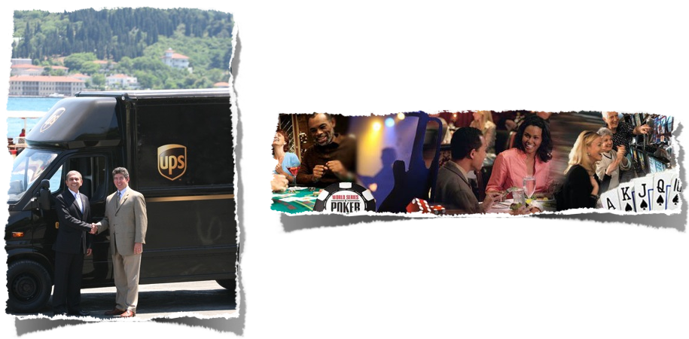
Operational

Slide 8
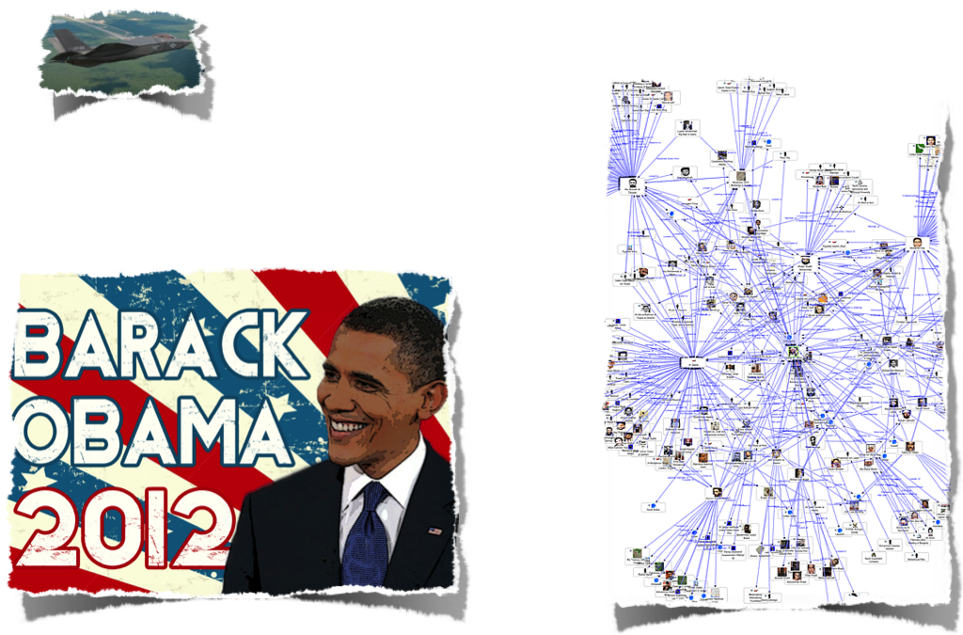
Social

Slide 9
Environmental

Slide 10
Digital transformation

Slide 11
Data
Data are the raw material for information
Ideally, the lower the level of detail the better
Summarize up but not detail down
Immutability means no updating
Append plus a time stamp
Maintain history

Slide 12
Data types
Structured
Unstructured
Can structure with some effort

Slide 13
Requirements for Big Data
Robust and fault-tolerant
Low latency reads and updates – faster access and updates
Scalable – robust against greater volume
Support a wide variety of applications
Extensible – different types of data
Ad hoc queries – flexible w.r.t business requirements
Minimal maintenance
Debuggable – easy to bug (modular)

Slide 14
Bottlenecks

Slide 15
Solving the speed problem

Slide 16
Lambda Architecture
a useful framework to think about designing big data applications.
Nathan Marz designed this generic architecture addressing common requirements for big data based on his experience working on distributed data processing systems at Twitter.

Slide 17
Lambda architecture
Speed layer
Serving layer
Batch layer

Slide 18
Batch layer
Addresses the cost problem
The batch layer stores the master copy of the dataset
A very large list of records
An immutable growing dataset
Continually pre-computes batch views on that master dataset so they available when requested
Might take several hours to run

Slide 19
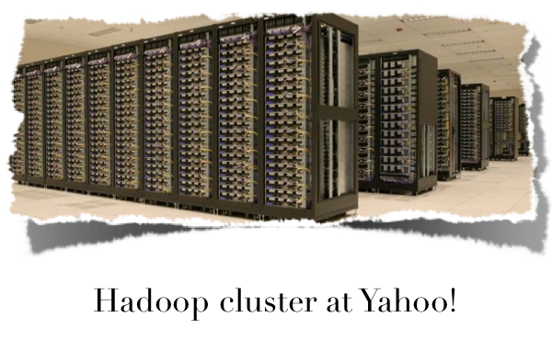
Batch programming
Automatically parallelized across a cluster of machines
Supports scalability to any size dataset
If you have an x nodes cluster, the computation will be about x times faster compared to a single machine

Slide 20
Serving layer
A specialized distributed database
Indexes pre-computed batch views and loads them so they can be efficiently queried
Continuously swaps in newer pre-computed versions of batch views

Slide 21
Serving layer
Simple database
Batch updates
Random reads
No random writes
Low complexity
Robust
Predictable
Easy to configure and manage

Slide 22
Speed layer
The only data not represented in a batch view are those data collected while the pre-computation was running
The speed layer is a real-time system to top-up the analysis with the latest data
Does incremental updates based on recent data
Modifies the view as data are collected
Merges the two views as required by queries

Slide 23
Lambda architecture

Slide 24
Speed layer
Intermediate results are discarded every time a new batch view is received
The complexity of the speed layer is “isolated”
If anything goes wrong, the results are only a few hours out-of-date and fixed when the next batch update is received

Slide 25
Lambda architecture

Slide 26
Lambda architecture
New data are sent to the batch and speed layers
New data are appended to the master dataset to preserve immutability
Speed layer does an incremental update

Slide 27
Lambda architecture
Batch layer pre-computes using all data
Serving layer indexes batch created views
Prepares for rapid response to queries

Slide 28
Lambda architecture
Queries are handled by merging data from the serving and speed layers

Slide 29

Lambda Architecture
Source

Slide 30
Lambda Architecture
Developers are free to invent/create technologies that do one or more things in the architecture.
MapReduce for the batch layer
‘Storm’ for the speed layer
Others:

Slide 31
Master dataset
Goal is to preserve integrity
Other elements can be recomputed
Replication across nodes
Redundancy is integrity

Slide 32
CRUD to CR
Create
Read
Update
Delete
Create
Read

Slide 33
Immutability exceptions
Garbage collection
Delete elements of low potential value
Don’t keep some histories
Regulations and privacy
Delete elements that are not permitted
History of books borrowed

Slide 34
Fact-based data model
Each fact is a single piece of data
Clare is female
Clare works at Bloomingdales
Clare lives in New York
Multi-valued facts need to be decomposed
Clare is a female working at Bloomingdales in New York
A fact is data about an entity or a relationship between two entities

Slide 35
Fact-based data model
Each fact has an associated timestamp recording the earliest time that the fact is believed to be true
For convenience, usually the time the fact is captured
Create a new data type of time series or attributes become entities
More recent facts override older facts
All facts need to be uniquely identified
Often a timestamp plus other attributes
Use a 64 bit nonce (number used once) field, which is a a random number, if timestamp plus attribute combination could be identical

Slide 36
Fact-based versus relational
Decision-making effectiveness versus operational efficiency
Days versus seconds
Access many records versus access a few
Immutable versus mutable
History versus current view

Slide 37
Schemas
Schemas increase data quality by defining structure
Catch errors at creation time when they are easier and cheaper to correct

Slide 38
Fact-based data model
Graphs can represent facts-based data models
Nodes are entities
Properties are attributes of entities
Edges are relationships between entities

Slide 39
Graph versus relational
Keep a full history
Append only
Scalable?

Slide 40
Solving the speed and cost problems

Slide 41
Hadoop
Distributed file system (approach)
Hadoop distributed file system (HDFS)
Distributed computation (approach)
MapReduce
Commodity hardware
A cluster of nodes
Watch Intro to Hadoop and MapReduce (Lesson 2) on Udacity.

Slide 42
Hadoop
Yahoo! uses Hadoop for data analytics, machine learning, search ranking, email anti-spam, ad optimization, ETL, and more
Over 40,000 servers
170 PB of storage
Notes:
Hadoop in Practice

Slide 43
Hadoop
Lower cost
Commodity hardware
Speed
Multiple processors

Slide 44
HDFS
Files are broken into fixed sized blocks of at least 64MB
Blocks are replicated across nodes
Parallel processing
Fault tolerance

Slide 45
HDFS
Node storage
Store blocks sequentially to minimize disk head movement
Blocks are grouped into files
All files for a dataset are grouped into a single folder
No random access to records
New data are added as a new file

Slide 46
HDFS
Scalable storage
Add nodes
Append new data as files
Scalable computation
Support of MapReduce
Partitioning
Group data into folders for processing at the folder level

Slide 47
Vertical partitioning

Slide 48
MapReduce
A distributed computing method that provides primitives for scalable and fault-tolerant batch computation
Ad hoc queries on large datasets are time consuming
Distribute the computation across multiple processors
Pre-compute common queries
Move the program to the data rather than the data to the program

Slide 49
MapReduce

Slide 50
MapReduce

Slide 51
MapReduce
Input
Determines how data are read by the mapper
Splits up data for the mappers
Map
Operates on each data set individually
Partition
Distributes key/value pairs to reducers

Slide 52
MapReduce
Sort
Sorts input for the reducer
Reduce
Consolidates key/value pairs
Output
Writes data to HDFS

Slide 53
Shuffle

Slide 54
Programming MapReduce

Slide 55
Map
A Map function converts each input element into zero or more key-value pairs
A “key” is not unique, and many pairs with the same key are typically generated by the Map function
The key is the field about which you want to collect data

Slide 56
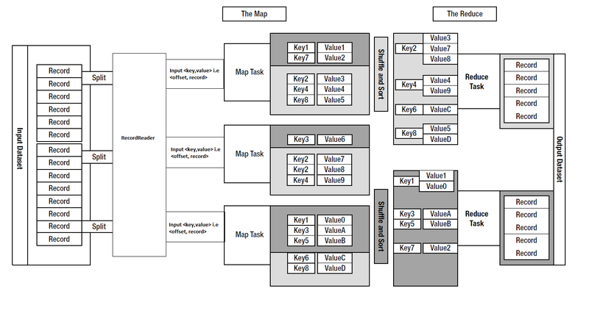
Processing Model
Source

Slide 57
Data Transformation Steps
Transformed from the input files and fed into the mappers
Transformed by the mappers
Sorted, merged, and presented to the reducer
Transform by reducers and written to output files

Slide 58
Map
Compute the square of a set of numbers
Input is (null,1), (null,2), …
Output is (1,1), (2,4), …
mapper <- function(k,v) {
key <- v
value <- key^2
keyval(key,value)
}

Slide 59
Reduce
A Reduce function is applied, for each input key, to its associated list of values
The result is a new pair consisting of the key and whatever is produced by the Reduce function
The output of the MapReduce is what results from the application of the Reduce function to each key and its list

Slide 60
Reduce
Report the number of items in a list
Input is (key, value-list), …
Output is (key, length(value-list)), …
reducer <- function(k,v) {
key <- k
value <- length(v)
keyval(key,value)
}

Slide 61
MapReduce API
A low-level Java implementation
Can gain additional compute efficiency but tedious to program
Try out highest-level options first and descend to lower levels if required

Slide 62
R & Hadoop
Compute squares

Slide 63
R
# create a list of 10 integers
ints <- 1:10
# equivalent to ints <- c(1,2,3,4,5,6,7,8,9,10)
# compute the squares
result <- sapply(ints,function(x) x^2)
result
[1] 1 4 9 16 25 36 49 64 81 100

Slide 64
Key-value mapping
Input | Map |  | Reduce | Output
(null,1) | (1,1) |  |  | (1,1)
(null,2) | (2,4) |  |  | (2,4)
… | … |  |  | …
(null,10) | (10,100) |  |  | (10,100)

Slide 65
Installing Package rmr2
Click on Install package in R and search for rmr2.
Or download the *.tar.gz file for the rmr2 package from the Internet and install it manually as follows
In Rstudio click Packages → Install
Under the dropdown box ‘Install from:’ click Package Archive File and point to the downloaded *.tar.gz file

Slide 66
MapReduce
require(rmr2)
rmr.options(backend = "local") # local or hadoop
# load a list of 10 integers into HDFS
hdfs.ints = to.dfs(1:10)
# mapper for the key-value pairs to compute squares
mapper <- function(k,v) {
key <- v
value <- key^2
keyval(key,value)
}
# run MapReduce
out = mapreduce(input = hdfs.ints, map = mapper)
# convert to a data frame
df1 = as.data.frame(from.dfs(out))
colnames(df1) = c('n', 'n^2')
#display the results
df1
MapReduce
No reduce

Slide 67
Exercise
Use the map component of the mapreduce() to create the cubes of the integers from 1 to 25

Slide 68
R & Hadoop
Tabulation

Slide 69
R
url <- "https://dl.dropbox.com/u/6960256/data/centralparktemps.txt"
t <- source_data(url, header=T, sep=',')
#convert and round temperature to an integer
t$temperature = round((t$temperature-32)*5/9,0)
# tabulate frequencies
table(t$temperature)

Slide 70
Key-value mapping
Input | Map (F to C) |  | Reduce | Output
(null,35.1) | (2,1) |  | (-7,c(1)) | (-7,1)
(null,37.5) | (3,1) |  | (-6,c(1)) | (-6,1)
… | … |  | … | …
(null,43.3) | (6,1) |  | (27,c(1,1,1,1,1,1,1,1)) | (27,8)

Slide 71
MapReduce (1)
install.packages(“repmis”)
require(repmis)
require(rmr2)
rmr.options(backend = "local") #local or hadoop
url <- "http://people.terry.uga.edu/rwatson/data/centralparktemps.txt"
t <- source_data(url, header=T, sep=',')
# save temperature in hdfs file
hdfs.temp <- to.dfs(t$temperature)
# mapper for conversion to C
mapper <- function(k,v) {
key <- round((v-32)*5/9,0)
value <- 1
keyval(key,value)
}
# Instead of function(k,v) one can also use (., v) because k is not being used.
MapReduce

Slide 72
MapReduce (2)
MapReduce
# reducer to count frequencies. Here the two arguments to function, k & v correspond to key and value from the map function.
reducer <- function(k,v) {
key <- k
value = length(v)
keyval(key,value)
}
out = mapreduce(
input = hdfs.temp,
map = mapper,
reduce = reducer)
df2 = as.data.frame(from.dfs(out))
colnames(df2) = c('temperature', 'count')
df2[order(df2$temperature),]

Slide 73
R & Hadoop
Basic statistics

Slide 74
R
url <- "https://dl.dropbox.com/u/6960256/data/centralparktemps.txt"
t <- source_data(url, header=T, sep=',')
a1 <- aggregate(t$temperature,by=list(t$year),FUN=max)
colnames(a1) = c('year', 'value')
a1$measure = 'max'
a2 <- aggregate(t$temperature,by=list(t$year),FUN=mean)
colnames(a2) = c('year', 'value')
a2$value = round(a2$value,1)
a2$measure = 'mean'
a3 <- aggregate(t$temperature,by=list(t$year),FUN=min)
colnames(a3) = c('year', 'value')
a3$measure = 'min'
# stack the results
stack <- rbind(a1,a2,a3)
library(reshape)
# reshape with year, max, mean, min in one row
stats <- cast(stack,year ~ measure,value="value")
head(stats)

Slide 75
Key-value mapping
Input | Map |  | Reduce | Output
(null,record) | (year, temperature) |  | (year, vector of temperatures) | (year, max) (year, mean) (year, min)

Slide 76
MapReduce (1)
require(rmr2)
require(reshape)
rmr.options(backend = "local") # local or hadoop
url <- "http://people.terry.uga.edu/rwatson/data/centralparktemps.txt"
t <- source_data(url, header=T, sep=',')
# save temperature in hdfs file
hdfs.temp <- to.dfs(t)
# mapper for computing temperature measures for each year
mapper <- function(.,v) {
key <- v[[1]] # year
value <- v[[3]] # temperature
keyval(key,value)
}
MapReduce

Slide 77
MapReduce (2)
#reducer to report stats
reducer <- function(k,v) {
key <- k #year
value <- c(max(v),round(mean(v),1),min(v)) #v is list of values for a year
keyval(key,value)
}
out = mapreduce(
input = hdfs.temp,
map = mapper,
reduce = reducer)
df3 = as.data.frame(from.dfs(out))
df3$measure <- c('max','mean','min')
# reshape with year, max, mean, min in one row
stats2 <- cast(df3,key ~ measure,value="val")
head(stats2)
MapReduce

Slide 78
R & Hadoop
Word counting

Slide 79
R
require(stringr)
# read as a single character string
t <- readChar("http://people.terry.uga.edu/rwatson/data/yogiquotes.txt", nchars=1e6)
t1 <- tolower(t[[1]]) # convert to lower case
t2 <- str_replace_all(t1,"[[:punct:]]","")
# get rid of punctuation
wordList <- str_split(t2, "\\s")
#split into strings
wordVector <- unlist(wordList)
# convert list to vector
table(wordVector)

Slide 80
Key-value mapping
Input | Map |  | Reduce | Output
(null, text) | (word,1) (word,1) … |  | (word, vector) … | word, length(vector) …

Slide 81
MapReduce (1)
require(rmr2)
require(stringr)
rmr.options(backend = "local") # local or hadoop
# read as a single character string
url <- "http://www.richardtwatson.com/dm6e/Reader/extras/yogiquotes.txt"
t <- readChar(url, nchars=1e6)
text.hdfs <- to.dfs(t)
mapper=function(k,v){
t1 <- tolower(v) # convert to lower case
t2 <- str_replace_all(t1,"[[:punct:]]","") # get rid of punctuation
wordList <- str_split(t2, "\\s") #split into words
wordVector <- unlist(wordList) # convert list to vector
keyval(wordVector,1)
}
MapReduce

Slide 82
MapReduce (2)
reducer = function(k,v) {
keyval(k,length(v))
}
out <- mapreduce (input = text.hdfs,
map = mapper,
reduce = reducer,combine=T)
# convert output to a frame
df1 = as.data.frame(from.dfs(out))
colnames(df1) = c('word', 'count')
#display the results
df1
MapReduce

Slide 83
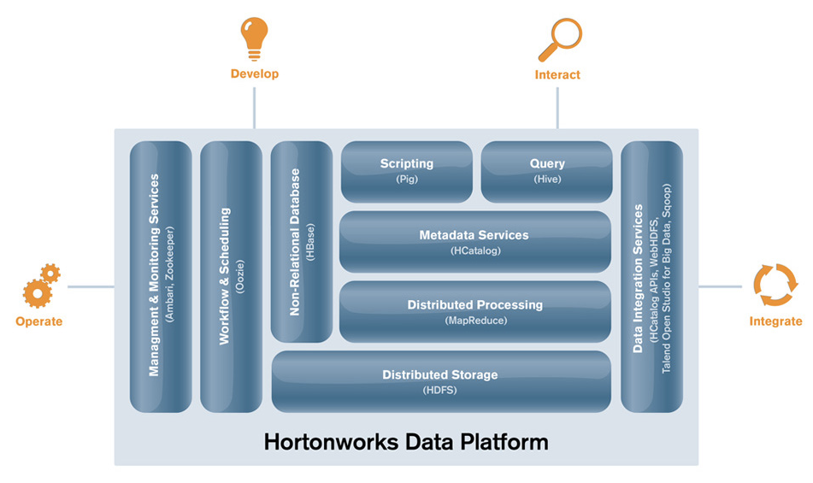
Hortonworks data platform

Slide 84
HBase
A distributed database
Does not enforce relationships
Does not enforce strict column data typing
Part of the Hadoop ecosytem

Slide 85
Applications
Facebook
Twitter
StumbleUpon

Slide 86
Hiring: learning from big data
People with a criminal background perform a bit better in customer-support call centers
Customer-service employees who live nearby are less likely to leave
Honest people tend to perform better and stay on the job longer
but make less effective salespeople

Slide 87
Outcomes
Scientific discovery
Quasars
Higgs Boson
Discovering linkages among humans, products, and services
An ecological sustainable society
Energy Informatics

Slide 88
Critical questions
What’s the business problem?
What information is needed to make a high quality decision?
What data can be converted into information?

Slide 89
Conclusions
Faster and lower cost solutions for data-driven decision making
HDFS
Reduces the cost of storing large data sets
Becoming the new standard for data storage
MapReduce is changing the way data are processed
Cheaper
Faster
Need to reprogram for parallelism

Slide 90
Hadoop Ecosystem
Ecosystem = Set of tools made by different vendors that fit into the Hadoop paradigm
http://www.revelytix.com/?q=content/hadoop-ecosystem
http://wikibon.org/wiki/v/HBase,_Sqoop,_Flume_and_More:_Apache_Hadoop_Defined

